Slide 1


Welcome to the YGCC’s
2017 Resume workshop
Yale Graduate Student Consulting Club (YGCC)
www.yalegradstudentconsulting.org
Date: 2017-02-14

Slide 2
Overview
    Consulting Job Application Process
    Resume Formatting
    Resume Example Case Study
    Peer Review
    Extra Resources

Slide 3


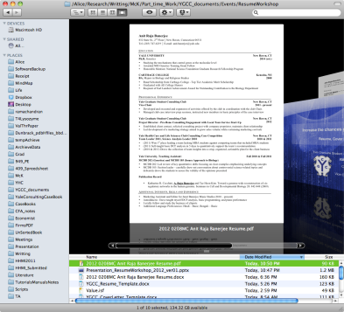

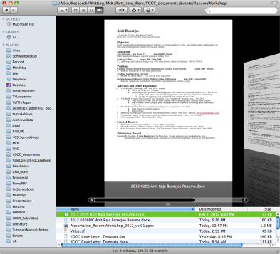



I. Consulting Job Application Process
    Submit a resume and cover letter
    First round interview
    Second round interview and/or final round interview
Why is your
resume important?
To convince them that you
deserve an interview
I
II
III
IV
V
Notes:
Easier definition: Consultants are hired by businesses to solve complex business problems that they don’t have the expertise or time to solve themselves!
- a former YGCC member who now works in the Cleveland office of McKinsey

Slide 4
I. Consulting Job Application Process
In most cases, the FIRST chance to tell a firm who you are
Sometimes will machine read the resume first (through applicant tracking system [ATS])
Recruiter
First pass: looking for key quantitative metrics
Second pass: looking for polished, tailored resume
Key values:
Analytical abilities
Collaboration/Experience in teams
Communication skills
Leadership/Management experiences
Accomplishments/History of achieving results
I
II
III
IV
V
Notes:
http://mashable.com/2013/11/11/resume-robots/#mB32br45saqV
https://resumegenius.com/blog/applicant-tracking-systems-resume-keyword-help

Slide 5
I. Consulting Job Application Process
Key Values | First Screen / ATS | HR / Recruiter
School / Degrees | ★ | ★
GPA / GRE / SAT | ★ | ★
Scholarships | ★ | ★
Academic Achievement |  | ★
Leadership | ★ | ★
Teamwork | ★ | ★
Impact | ★ | ★
Business Experience |  | ★
Skills
Extracurriculars
Personal Interests
I
II
III
IV
V
Notes:
Screen 1) I deserve a second look by HR / Recruiter
Screen 2) I deserve an interview, look at all these achievements and skills
Step 3) I deserve a job, ask me about these

Slide 6
I. Consulting Job Application Process
Key Values | First Screen / ATS | HR / Recruiter | Interviews
School / Degrees | ★ | ★ | ★
GPA / GRE / SAT | ★ | ★
Scholarships | ★ | ★
Academic Achievement |  | ★ | ★
Leadership | ★ | ★ | ★
Teamwork | ★ | ★ | ★
Impact | ★ | ★ | ★
Business Experience |  | ★ | ★
Skills |  |  | ★
Extracurriculars |  |  | ★
Personal Interests |  |  | ★
I
II
III
IV
V
Notes:
Screen 1) I deserve a second look by HR / Recruiter
Screen 2) I deserve an interview, look at all these achievements and skills
Step 3) I deserve a job, ask me about these

Slide 7

II. Resume - Formatting
Why is formatting so important?
Organization improves digestion of a lot of information
Example Layout
Academic Achievement
Professional Experience
Leadership Experience
Business Experience
Additional Information
(Skills, extracurriculars, interest)
I
II
III
IV
V
Notes:
Stick to a common font like Times New Roman or Ariel, and avoid text boxes, underlining, or shading. Font size should be between 10 and 12 point, and kept consistent throughout the document. Margins should be equal all the way around the page, and should be at least three quarters of an inch in size.
Ref: Harvard OCS-GSAS resume & coverletter

Slide 8
II. Resume - Formatting
Why is formatting so important?
Organization improves digestion of a lot of information
Example Layout
Font: Times New Roman, Arial, Calibri
Font size: 10-12 point (except titles, name)
Margins: min. 0.5 inch
I
II
III
IV
V
Notes:
Stick to a common font like Times New Roman or Ariel, and avoid text boxes, underlining, or shading. Font size should be between 10 and 12 point, and kept consistent throughout the document. Margins should be equal all the way around the page, and should be at least three quarters of an inch in size.
Ref: Harvard OCS-GSAS resume & coverletter

Slide 9
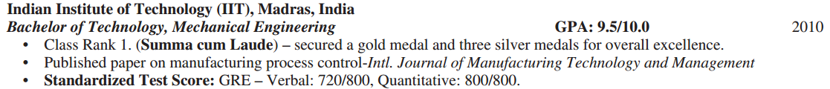
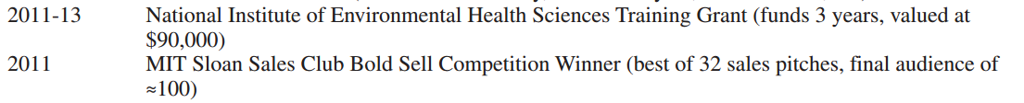
II. Sections – Academic
Goal: Academic Achievement
  Numbers (GPA/GRE/SAT/Scholarships/Grants)
    List relevant test scores and GPA (with scale)
    Give dollar amounts over award period
    Give context for achievement: recipient rate, nominations, etc.
  Examples
I
II
III
IV
V
Notes:
http://mashable.com/2013/11/11/resume-robots/#mB32br45saqV
https://resumegenius.com/blog/applicant-tracking-systems-resume-keyword-help

Slide 10
II. Sections – Academic
Goal: Relate your research
  Impact (Research topic)
    Avoid jargon!
    Think of research as an end goal to the public (how could your research inform/help society?)
  Examples
    Managed a group of researchers that led to publication in Nature Immunology
    Collaborated with researchers from Korea and Spain to investigate bacteria driven inflammation
    Research protein making machinery as potential novel anti-parasitic drug target
I
II
III
IV
V
Notes:
http://mashable.com/2013/11/11/resume-robots/#mB32br45saqV
https://resumegenius.com/blog/applicant-tracking-systems-resume-keyword-help

Slide 11
II. Sections – Leadership/Business Experience
Goal: Demonstrate your ability to impact positive change
  Key Ideas:
    Quantitative metrics, numbers (ex. $ raised or under budget, club members, etc.)
    Positive change (ex. increase in attendance, decrease waste, etc.)
    Working with diverse set of people
  Leadership
    Title is less important than impact
    Ex. Managed a budget of $5,000 for seminars encouraging science education with an audience of 1,000
  Teamwork
    Created an innovative career development program with a team of PhDs, MBAs, and MPHs leading to 50 confirmed job offers
  Business Interest
    Analyzed coffee market for a start-up to create a marketing strategy
I
II
III
IV
V
Notes:
http://mashable.com/2013/11/11/resume-robots/#mB32br45saqV
https://resumegenius.com/blog/applicant-tracking-systems-resume-keyword-help

Slide 12
II. Sections – Skills/Extracurriculars/Interests
Goal: Show individuality
  Hobbies
    Event planner for 4 campus wide events, department recruitment organizer, award winning debater
    Amateur beer brewer, chess champion, running
  Skills
    CFA level II, PYTHON, French (fluent)
I
II
III
IV
V
Notes:
Demonstrate the same qualities as in previous sections. Leadership Teamwork Impact
Skills – highlight if unusual or difficult to obtain

Slide 13
II. Sections – Publications???
List publications only if it will be appreciated
  High visibility brands
    Journals: Science, Nature, Cell
    Associated with well-known press releases, topical events, etc.
  Specialized firms
    Recruiter will be familiar with your field and journals (ClearView, L.E.K., etc.)
    Check company message and position title (Life Science Specialist, etc.)
I
II
III
IV
V
Notes:
Demonstrate the same qualities as in previous sections. Leadership Teamwork Impact
Skills – highlight if unusual or difficult to obtain

Slide 14
III. Key Tips to Improve Your Resume
Use consistent formatting (dates, numbers, punctuation)
Use Active Words
Show Impact
Keep Revising
Example Layout
Position – Organization Start time – End time (present)
Executive summary (optional)
Bullet 1
Bullet 2
I
II
III
IV
V
Notes:
http://mashable.com/2013/11/11/resume-robots/#mB32br45saqV
https://resumegenius.com/blog/applicant-tracking-systems-resume-keyword-help

Slide 15
III. Key Tips - Active Words
Sample “action verbs”
Achievement | Lead/Manage | Communication | Creative
Achieved Accomplished Accelerated Attained Elicited Executed Expanded Improved Insured … | Acquired Assigned Directed Initiated Managed Motivated Recruited Supervised … | Addressed Articulated Conducted Delivered Interviewed Lectured Negotiated Persuaded Proposed … | Conceived Constructed Created Developed Drafted Formulated Launched Originated …
Resources: “Harvard OCS GSAS: Resume and Cover Letters”
I
II
III
IV
V

Slide 16



III. Key Tips - Show Impact
Head organizer for the 2014 Life Sciences Casebook
Generated the 100-page Life Sciences Casebook covering business strategy in healthcare, 130 downloads to date
For each line keep asking, “can I add numbers to show impact?” or “leading to what?”
More examples:
Example
Developed and executed expansion of club in coordination with club Chair which resulted in 3 new workshops and a 200% increase in attendance
Example
Doubled the offer rate from top management consulting firms by designing 3 new workshops, launching a yearly case competition and organizing alumni events
I
II
III
IV
V

Slide 17
III. Key Tips – Show Impact
Not enough to list what you did. Need to explain why it was meaningful.
Focus on Results and Accomplishments – quantify as much as possible
If you can’t quantify results in numbers, explain results qualitatively
Example
Created marketing campaign that improved sales 20%
[Comment]: Quantify the accomplishments in percentage of sales growth
Example
Revamped in-patient process which resulted in enhanced experience for clientele
[Comment]: Focus on the qualitative results
Resources: Yale OCS Resumes website
I
II
III
IV
V

Slide 18
IV. Peer Review
Pick one resume
5-10 minute editing
5-10 min discuss
Formatting
Academic Achievement
Business Experience
Leadership
Teamwork
Impact
Numbers
Extracurricular
Questions to think about
What catches your eye?
What impresses you?
What is difficult to understand?
What could be enumerated?
I
II
III
IV
V
Notes:
-remember to sign up for email lists for the big firm publications!

Slide 19
V. Extra Resources
Yale Office of Career Services
  Appointments for resumes, cover letter, fit interviews
Resume and cover letter guide (HES)
Resume and cover letter guide (Stanford)
Career guide, pp. 20-39 (Stanford)
Resume writing (UPenn)
Sample resumes (MIT Sloan)
Resume guide (Dartmouth Tuck)
I
II
III
IV
V
Notes:
http://ocs.fas.harvard.edu/files/ocs/files/phd_resume_cover_letters.pdf?m=1438112283
http://ocs.yale.edu/content/resumes
http://ocs.yale.edu/content/cover-letters

